Slide 1
Internet Protocol
Datagram Structure
Fragmentation

Slide 2
20-2 IPv4
The Internet Protocol version 4 (IPv4) is the delivery mechanism used by the TCP/IP protocols.

Slide 3
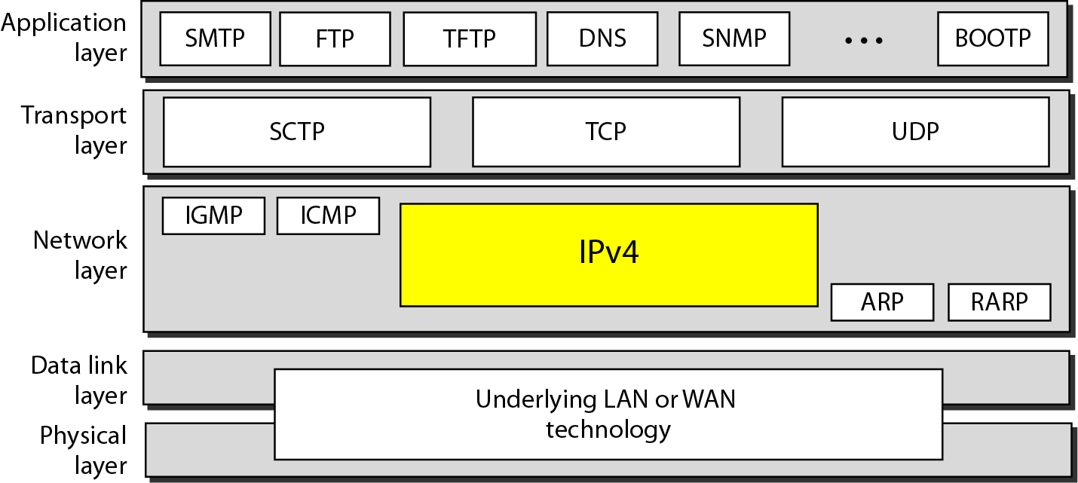
Figure 20.4 Position of IPv4 in TCP/IP protocol suite

Slide 4
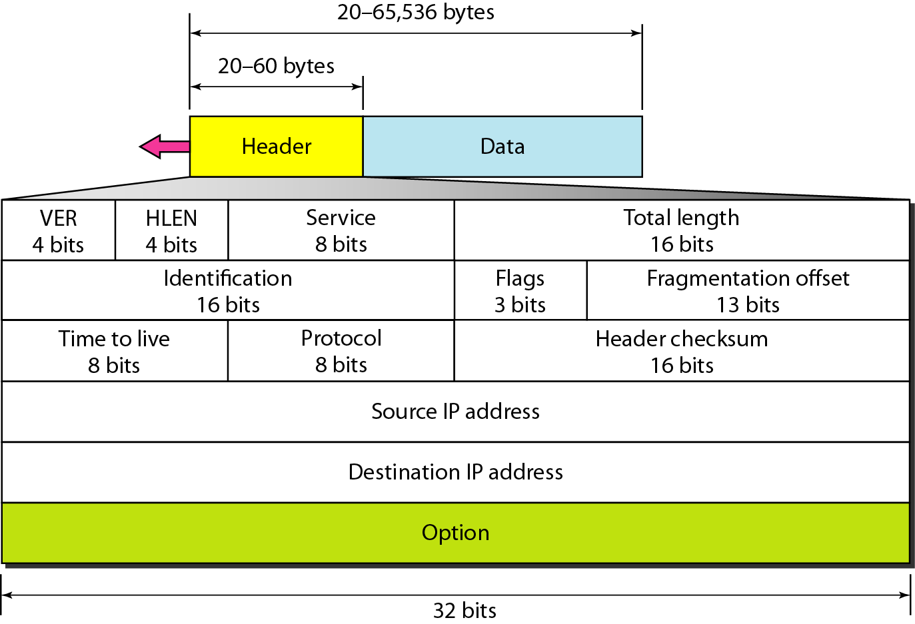
Figure 20.5 IPv4 datagram format

Slide 5
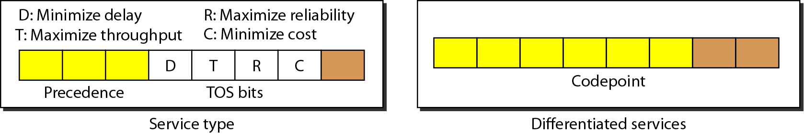
Figure 20.6 Service type or differentiated services

Slide 6
Table 20.1 Types of service

Slide 7

Note
The total length field defines the total length of the datagram including the header.

Slide 8
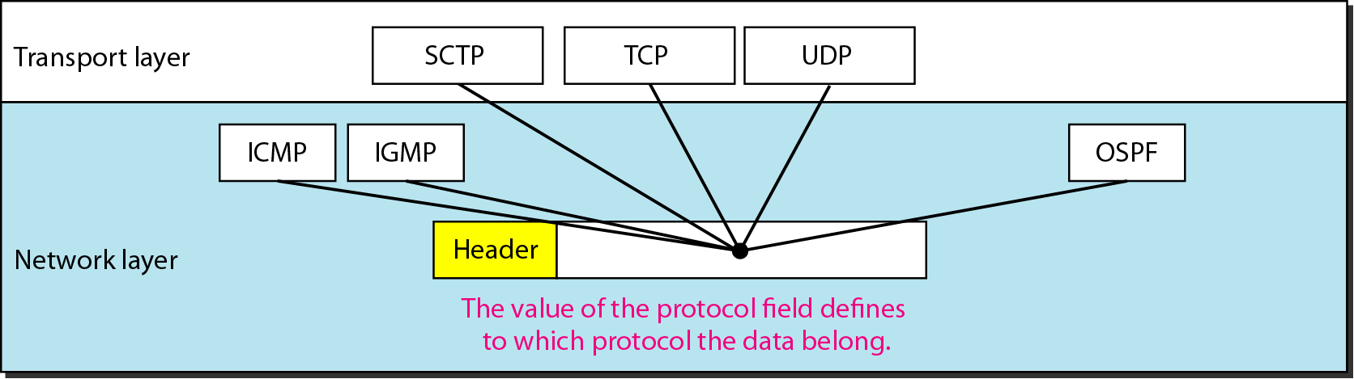
Figure 20.8 Protocol field and encapsulated data

Slide 9
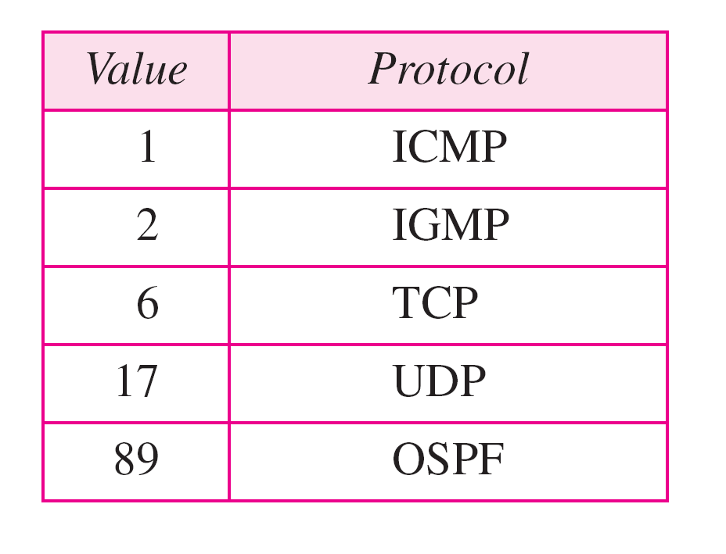
Table 20.4 Protocol values

Slide 10
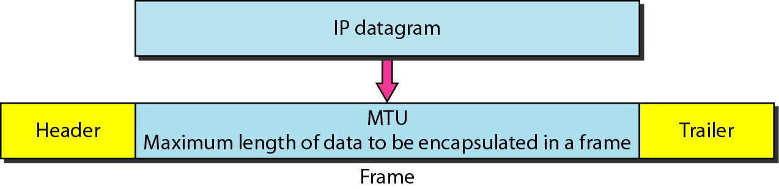
Figure 20.9 Maximum transfer unit (MTU)

Slide 11
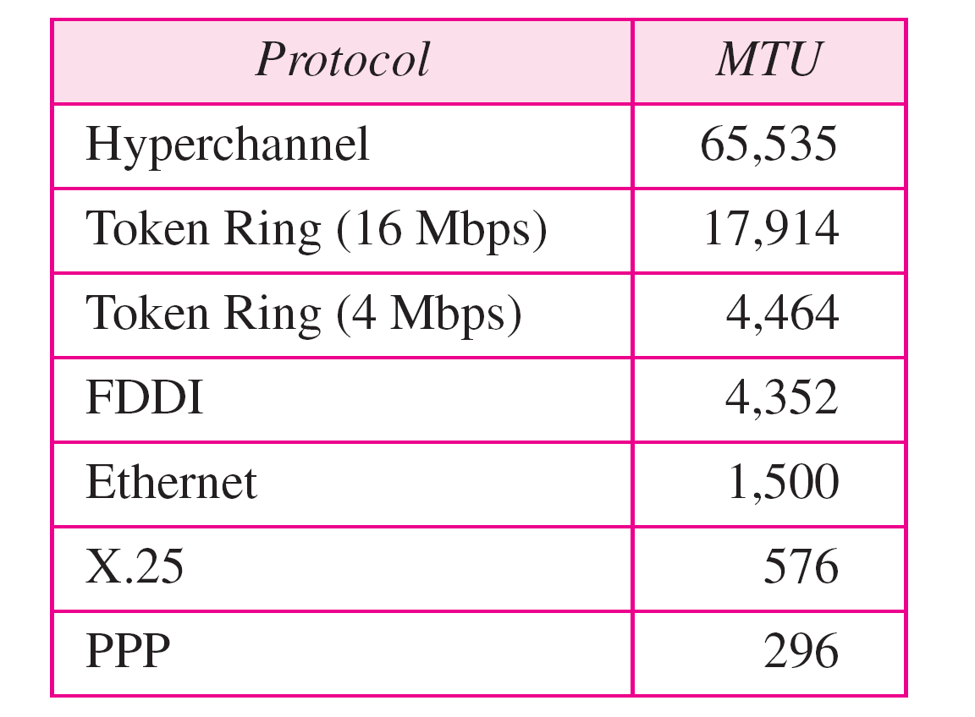
Table 20.5 MTUs for some networks

Slide 12

Figure 20.10 Flags used in fragmentation

Slide 13
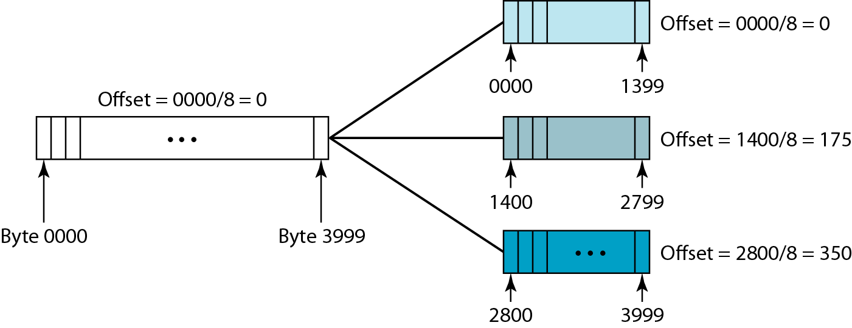
Figure 20.11 Fragmentation example

Slide 14
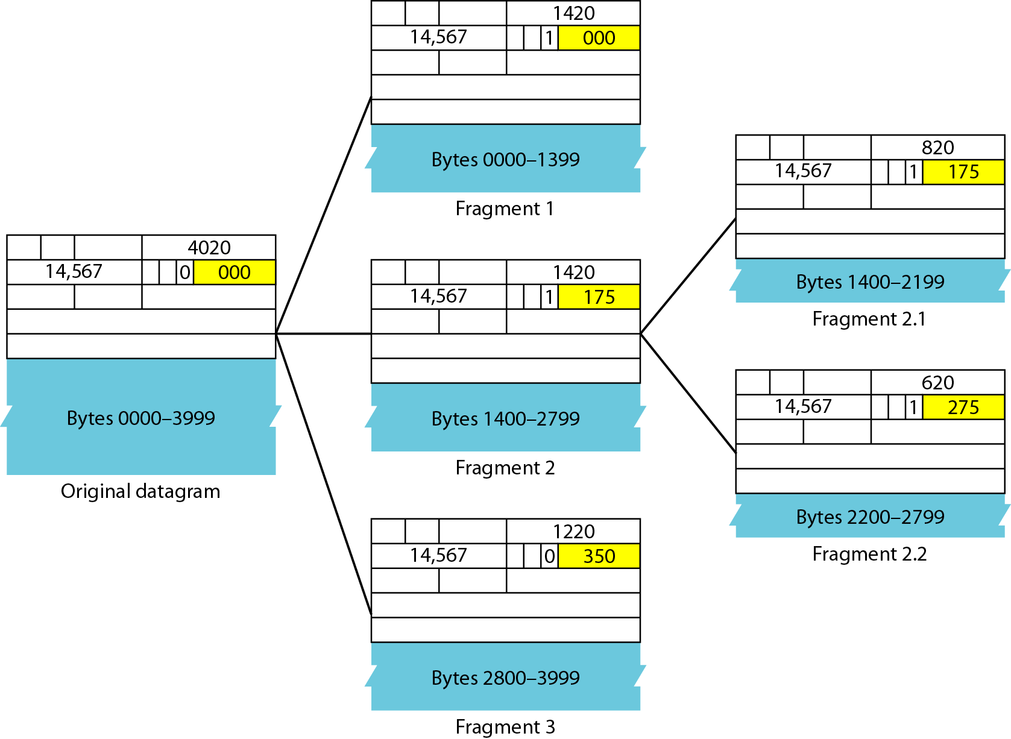
Figure 20.12 Detailed fragmentation example

Slide 15
Example 20.5
A packet has arrived with an M bit value of 0. Is this the first fragment, the last fragment, or a middle fragment? Do we know if the packet was fragmented?
Solution
If the M bit is 0, it means that there are no more fragments; the fragment is the last one. However, we cannot say if the original packet was fragmented or not. A non-fragmented packet is considered the last fragment.

Slide 16
Example 20.6
A packet has arrived with an M bit value of 1. Is this the first fragment, the last fragment, or a middle fragment? Do we know if the packet was fragmented?
Solution
If the M bit is 1, it means that there is at least one more fragment. This fragment can be the first one or a middle one, but not the last one. We don’t know if it is the first one or a middle one; we need more information (the value of the fragmentation offset).

Slide 17
Example 20.7
A packet has arrived with an M bit value of 1 and a fragmentation offset value of 0. Is this the first fragment, the last fragment, or a middle fragment?
Solution
Because the M bit is 1, it is either the first fragment or a middle one. Because the offset value is 0, it is the first fragment.

Slide 18
Example 20.8
A packet has arrived in which the offset value is 100. What is the number of the first byte? Do we know the number of the last byte?
Solution
To find the number of the first byte, we multiply the offset value by 8. This means that the first byte number is 800. We cannot determine the number of the last byte unless we know the length.

Slide 19
Example 20.9
A packet has arrived in which the offset value is 100, the value of HLEN is 5, and the value of the total length field is 100. What are the numbers of the first byte and the last byte?
Solution
The first byte number is 100 × 8 = 800. The total length is 100 bytes, and the header length is 20 bytes (5 × 4), which means that there are 80 bytes in this datagram. If the first byte number is 800, the last byte number must be 879.

Slide 20
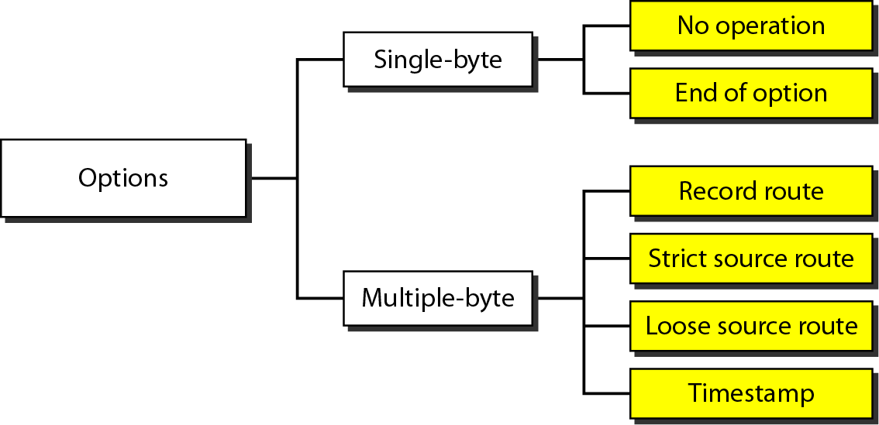
Figure 20.14 Taxonomy of options in IPv4

Slide 21
James Kurose version of IP Header structure

Slide 22
The Internet network layer
host, router network layer functions:
transport layer: TCP, UDP
routing protocols
path selection
RIP, OSPF, BGP
IP protocol
addressing conventions
datagram format
packet handling conventions
network
layer
forwarding
table
ICMP protocol
error reporting
router “signaling”
link layer
physical layer

Slide 23
IP datagram format
IP protocol version
number
32 bits
total datagram
length (bytes)
header length
(bytes)
head.
len
type of
service
ver
length
for
fragmentation/
reassembly
“type” of data
flgs
fragment
offset
16-bit identifier
max number
remaining hops
(decremented at
each router)
time to
live
upper
layer
header
checksum
32 bit source IP address
upper layer protocol
to deliver payload to
32 bit destination IP address
options (if any)
e.g. timestamp,
record route
taken, specify
list of routers
to visit.
data
(variable length,
typically a TCP
or UDP segment)
how much overhead?
20 bytes of TCP
20 bytes of IP
= 40 bytes + app layer overhead

Slide 24

IP fragmentation, reassembly
network links have MTU (max.transfer size) - largest possible link-level frame
different link types, different MTUs
large IP datagram divided (“fragmented”) within net
one datagram becomes several datagrams
“reassembled” only at final destination
IP header bits used to identify, order related fragments
…
fragmentation:
in: one large datagram
out: 3 smaller datagrams
reassembly
…

Slide 25
IP fragmentation, reassembly
length
=4000
ID
=x
fragflag
=0
offset
=0
example:
4000 byte datagram
MTU = 1500 bytes
one large datagram becomes
several smaller datagrams
1480 bytes in data field
length
=1500
ID
=x
fragflag
=1
offset
=0
offset =
1480/8
length
=1500
ID
=x
fragflag
=1
offset
=185
length
=1040
ID
=x
fragflag
=0
offset
=370

